Slide 1
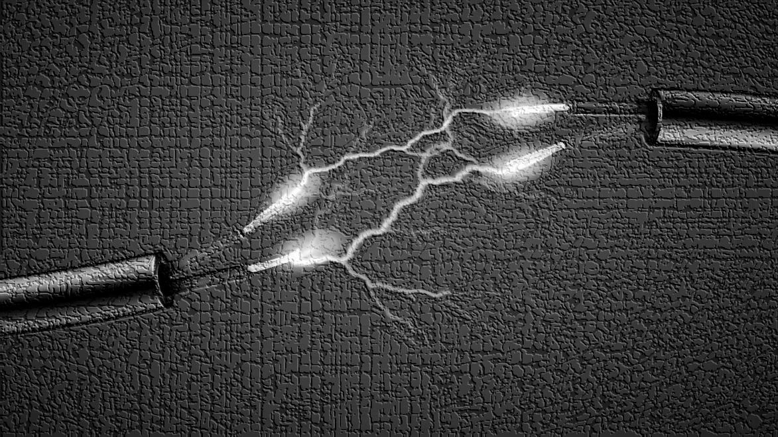
Vidhyadeep Institute Of Management & Technology, Anita, Kim
Electronics & Communication Department
ELECTRICAL PROTECTIVE
DEVICE
Guided by Mr. Vicky Paperwala

Slide 2
Protective
Device
Help to ensure safe and healthy working conditions
Prevents damage to an electrical system.
Protect from the risk of injury.
It include circuit breaker and fuse.

Slide 3
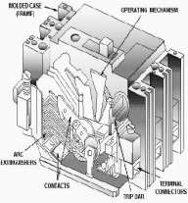
Protective Devices
1. Fuse
2. Circuit breaker
MCB
MCCB
ELCB
1.
2.
3.

Slide 4
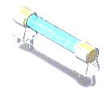
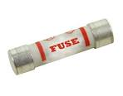
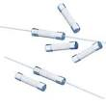
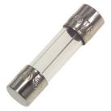
FUSE
A type of low resistance resistor to provide overcurrent protection.
Prevents short-circuiting, overloading, mismatched loads or device failure.

Slide 5
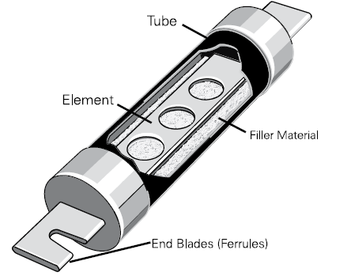
FUSE CONSTRUCTION
The size and construction of the element is determined so that the heat produced for a normal current does not cause the element to attain a high temperature.

Slide 6
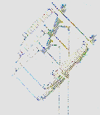
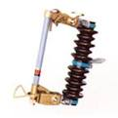
TYPES OF FUSES
FUSE
LOW VOLTAGE FUSE
REWIREABLE
CARTRIDGE
HIGH VOLTAGE FUSE

Slide 7
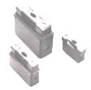
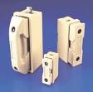
REWIREABLE TYPE
(SEMI ENCLOSED TYPE)
This kind of fuse is most commonly used in the case of domestic wiring and small scale usage.
The main advantage of this type of fuse is that it is easy to install and also replace without risking any electrical injury. But there are certain shortcomings associated with it too.

Slide 8
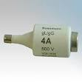
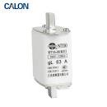
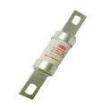
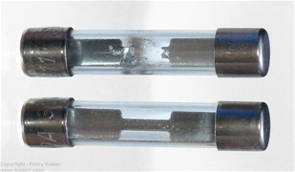
CARTRIDGE TYPE
(TOTALLY ENCLOSED TYPE)
The level of sub division in this case includes:
1.D type
2.Link Type
Link type further divided into
1.Knife blade type HRC fuse
2.Botled type HRC link fuse

Slide 9
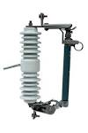
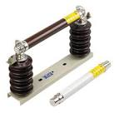
HIGH VOLTAGE FUSE
High-voltage fuses are used to protect instrument transformers used for electricity metering, or for small power transformers where the expense of a circuit breaker is not warranted.

Slide 10
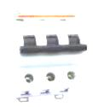
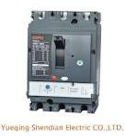
CIRCUIT BREAKER
A circuit breaker is a manually or automatically operated electric switch designed to protect an electrical circuit from damage caused by overload or short circuit.

Slide 11
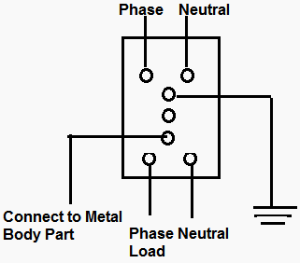
ELCB
A safety device used in electrical installations with high earth impedance to prevent shock.
A device used to directly detect currents leaking to earth from an installation and cut the power and mainly used in TT earthing systems.
There are two types of ELCBs:
1. Voltage Earth Leakage circuit breaker (voltage-ELCB) 2. Current Earth Leakage Current Earth Leakage Circuit Breaker (Current-ELCB).

Slide 12
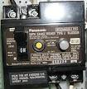
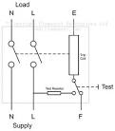
Voltage - ELCB
A voltage-operated ELCB detects a rise in potential between the protected interconnected metalwork (equipment frames, conduits, enclosures) and a distant isolated earth reference electrode.
Disadvantages of the voltage-operated ELCB are the requirement for a second connection, and the possibility that any additional connection to earth on the protected system can disable the detector.

Slide 13
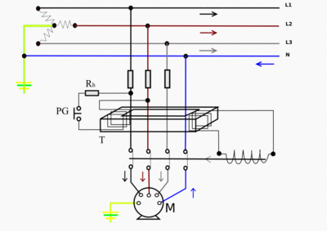
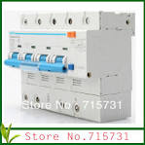
CURRENT ELCB
An electrical wiring device that disconnects a circuit whenever it detects that the electric current is not balanced between the energized conductor and the return neutral conductor.

Slide 14
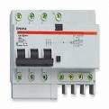
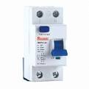
ADVANTAGES AND DISADVANTAGES
ELCBs have one advantage over RCDs: they are less sensitive to fault conditions, and therefore have fewer nuisance trips.
1.As with RCDs, electrically leaky appliances such as some water heater, washing machine may cause the ELCB to trip.
2.ELCBs introduce additional resistance and an additional point of failure into the earthing system

Slide 15
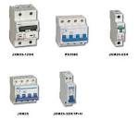
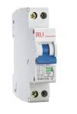
MCB
Miniature circuit breaker
It automatically switches off the electrical circuit during abnormal condition of the network means in over load condition as well as faulty condition.
MCB is much more sensitive to over current than fuse.

Slide 16
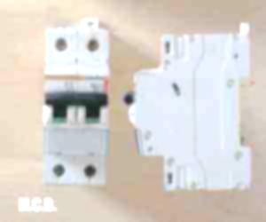
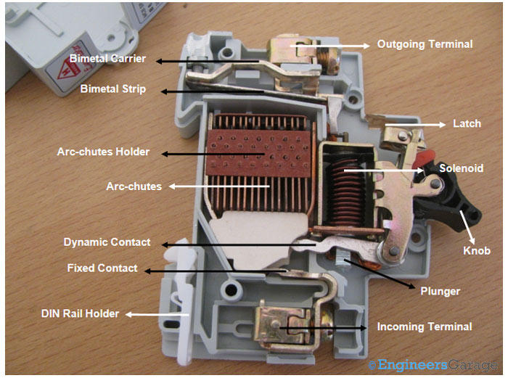
Miniature Circuit Breaker
Working Principle
There are two arrangement of operation of miniature circuit breaker.
1.One due to thermal effect of over current 2.electromagnetic effect of over current.

Slide 17
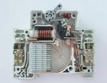
ADVANTAGES
1. It automatically switches off the electrical circuit during abnormal condition of the network means in over load condition as well as faulty condition.
2. Handling MCB is more electrically safe than fuse.
3. Another advantage is, as the switch operating knob comes at its off position during tripping, the faulty zone of the electrical circuit can easily be identified.

Slide 18
COMPARISON
SR.NO | PARTICULAR | FUSE | CIRCUIT BREAKER
1. | FUNCTION | PERFORMS DETECTION & INTERRUPTION FUNCTION | PERFORMS INTERRUPTON
2. | OPERATION | INHERENTLY COMPLETELY AUTOMATIC | REQUIRES ELABORATE EQUIPMENT
3. | BREAKING CAPACITY | SMALL | VERY LARGE
4. | OPERATING TIME | VERY SAMLL | VERY LARGE
5. | REPLACEMENT | REQUIRES | DOES NOT REQUIRE

